Slide 1
Particle Collisions in Two Dimensions
Dr. Jacob Moore
Associate Professor of Engineering
Penn State Mont Alto

Slide 2
Collisions and Impulse
One instance in which the impulse momentum equations are particularly useful is when we have bodies colliding.
If a collision between two bodies occurs quickly…
We will have a system of particles, and we will analyze the system as a whole with one impulse momentum equation
The internal impulses exerted between the bodies colliding will cancel each other out (because of Newton’s Third Law)
External impulses will generally be negligible because of the short time frame (they will be dwarfed by the magnitude of the internal forces of the collision)

Slide 3


Conservation of Momentum in 2D
Our original equation for the conservation of momentum in a system of particles was as follows
$$m_{A}{\vec{v}}_{Af}+m_{B}{\vec{v}}_{Bf}=m_{A}{\vec{v}}_{Ai}+m_{B}{\vec{v}}_{Bi}$$
In a 2D system, we will break these vectors down into components.
$$m_{A}v_{Afx}+m_{B}v_{Bfx}=m_{A}v_{Aix}+m_{B}v_{Bix}$$
$$m_{A}v_{Afy}+m_{B}v_{Bfy}=m_{A}v_{Aiy}+m_{B}v_{Biy}$$

Slide 4
Supplementing Our Conservation of Momentum Equation
With two equations (the conservation of momentum equations) we will be able to solve for two unknown.
Since this usually isn’t enough, we will need to get a third and usually fourth equation so we can solve for extra unknowns (usually the final velocity components for each particle).
The other equations we use will depend upon the type of collision
Conservation of momentum is always used, regardless of collision type.

Slide 5
Types of Collisions
Perfect Bounce
Elastic collisions:
Usually a good approximation of two rigid bodies colliding without permanent deformation.
100% of the kinetic energy is conserved.
Semi-Elastic collisions:
Somewhere between elastic and inelastic.
More kinetic energy conserved than in inelastic collision, less than 100% of kinetic energy conserved though.
Coefficient of restitution relates kinetic energy before to kinetic energy after.
Inelastic collisions
Occurs when bodies stick together after colliding.
Velocities of two bodies are the same after collision.
Lowest amount of kinetic energy conserved (still some is conserved)
Some Bounce
No Bounce

Slide 6
Inelastic Collisions
Because the bodies in an inelastic collision stick together post impact, the final velocities of both bodies (both components) will be the same.
Combining that with the conservation of momentum equations, and simplifying the results leads to the following equations.
$$\left(m_{A}+m_{B}\right)v_{fx}=m_{A}v_{Aix}+m_{B}v_{Bix}$$
$$\left(m_{A}+m_{B}\right)v_{fy}=m_{A}v_{Aiy}+m_{B}v_{Biy}$$
For inelastic equations, we can use any coordinate system so long as we are consistent.

Slide 7
Elastic and Semi-Elastic Collisions
For both elastic and semi-elastic collisions we are going to use the same strategy, using the coefficient of restitution rather than the conservation of energy.
This strategy relies on using a specific coordinate system, the normal and tangential coordinate system, so make sure to label these on your diagram, and break any known velocities down into normal and tangential components.
n
t
Plane of Contact

Slide 8
Elastic and Semi-Elastic Collisions
If we use these coordinates, we can generate four possible equations.
The first is just the conservation of momentum in the normal direction for the system
$$m_{A}v_{AfN}+m_{B}v_{BfN}=m_{A}v_{AiN}+m_{B}v_{BiN}$$
n
t
Plane of Contact

Slide 9
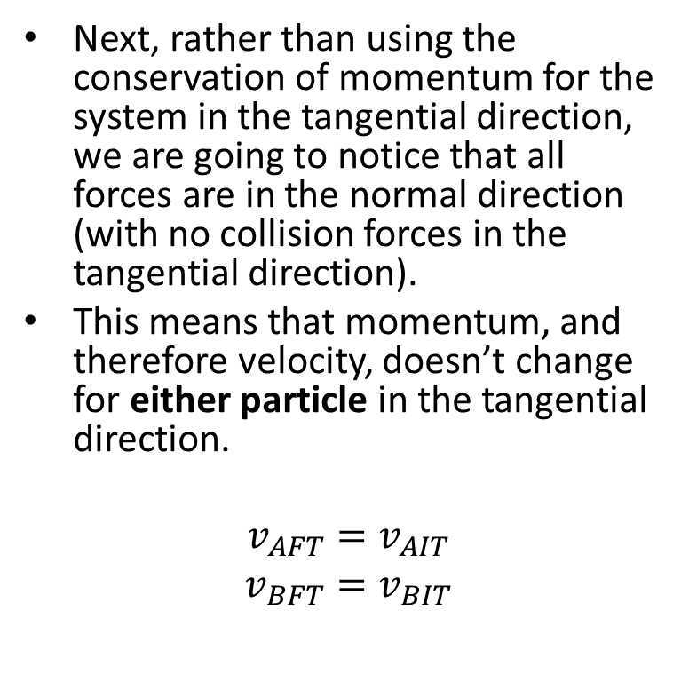
Elastic and Semi-Elastic Collisions
Next, rather than using the conservation of momentum for the system in the tangential direction, we are going to notice that all forces are in the normal direction (with no collision forces in the tangential direction).
This means that momentum, and therefore velocity, doesn’t change for either particle in the tangential direction.
$$v_{AFT}=v_{AIT}$$
$$v_{BFT}=v_{BIT}$$
n
t
Plane of Contact

Slide 10
Elastic and Semi-Elastic Collisions
For our last equation, we will use the definition of the coefficient of restitution, which relates velocities in the normal direction.
$$e=−\frac{v_{AFN}−v_{BFN}}{v_{AIN}−v_{BIN}}$$
For elastic collisions, remember that $e$ is equal to one.
n
t
Plane of Contact

Slide 11
Elastic and Semi-Elastic Collisions
Pulling it all together…
$$m_{A}v_{AfN}+m_{B}v_{BfN}=m_{A}v_{AiN}+m_{B}v_{BiN}$$
$$v_{AFT}=v_{AIT}$$
$$v_{BFT}=v_{BIT}$$
$$e=−\frac{v_{AFN}−v_{BFN}}{v_{AIN}−v_{BIN}}$$
n
t
Plane of Contact

Slide 12
Solving a Collision Problem (The Process)
Solving collision involves three steps, carefully accounting for the factors at play between some initial state and some final state.
Set up a diagram showing the initial and final velocities of the two particles both before and after the impact.
Identify the known or unknown velocities in each state
Identify the type of collision, and the coefficient of restitution if applicable
Label the normal and tangential directions for all elastic and semi-elastic collisions
Use the diagram to put together the conservation of momentum equation(s) along with the other appropriate equation for the collision type.
You will need to break all know velocities into component directions
Solve the equations for the unknown quantities

Slide 13
Thanks for Watching
See other engineering mechanics videos and access the full tool at…

Slide 14
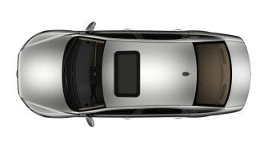
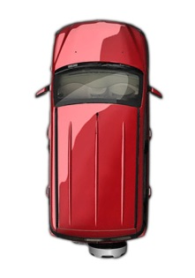
Inelastic Collision in 2D Practice Problem
Two cars collide at an intersection as shown below. The cars become entangled with one another making the collision an inelastic collision. Based on the information given on the initial state and if the two cars slide away from the crash at a 30º angle as shown, what must the initial velocity of car B been before the impact.
A
m = 1000 kg
25 kph
30º
B
m = 1500 kg

Slide 15
Semi-Elastic Collision in 2D Worked Example
Two pucks as shown below collide obliquely while sliding on a smooth surface as shown below. If the coefficient of restitution is .7 and time of impact is .001s...
What is the final speed of each puck?
What is the average force on each puck during the collision?
5 lb
6 ft/s
2 lb
3 ft/s

